Slide 1

PROBABiLITY
Santosh Chhatkuli

Slide 2
Terminology used in probability
Probability: It is the chance or likelihood that a particular event will occur
Random Experiment or Probability Experiment or Statistical Experiment: It is the chance process that leads to well defined result called outcomes.
Outcomes: An outcome is the result of a single trial of a random experiment.
Trial: A single performance of a random experiment is called a trial.
Event: An event is one or more of possible outcome of random experiment. It can be one outcome or more than one outcome. It is the subset of sample space.
Sample Space: It is the set of all possible outcomes of a random experiment. It is denoted by symbol ‘S’

Slide 3

Example of sample space
Random Experiment | Sample Space
Tossing two coins simultaneously | S = {HH, HT, TH, TT}
Rolling a dice | S = { }
Blood Typing | S = {A, B, O, AB}
Result of diagnostic test | S = { positive, negative}
No. of goals in the match | S = {0, 1, 2, 3, ….}
Entrance score of students (Qualifying mark is 40 suppose) | S = {40, 40.1, …., 99.9, 100}
Browsing time in minutes per visit | S = {0, 0.1, …, 1, 1.1, …}

Slide 4
Types of Events
Sure Event: A event is said to sure if its occurrence is 100 % sure. Prob (sure event) = 1
Impossible Event: An event is said to be impossible if it can never occur. Prob (impossible event) = 0
Simple Event: An event which can’t be decomposed into two or more different simple events. It is one event.
Compound Event: An event is said to be compound if it consists of two or more simple events.
Events
Simple Events
Compound Events
Mutually Exclusive Events
Equally Likely Events
Independent Events
Exhaustive Events
Dependent Events
Coin | DIE
 | 1 | 2 | 3 | 4 | 5 | 6
H | H1 | H2 | H3 | H4 | H5 | H6
T | T1 | T2 | T3 | T4 | T5 | T6

Slide 5
5. Mutually Exclusive Events: Two or more events are called mutually exclusive if they can’t occur together.
Example 1: Tossing a coin
Event H = Getting a head
Event T = Getting a tail
Example 2: Randomly selecting a person
Event S = A person is smoker
Event N = A person is non-smoker
Example 3: Randomly selecting a person
Event D = A person is drinker
Event S = A person is smoker
Example 4: Result of exam
Event P = Passing an exam
Event F = Failing an exam
Example 5: Lab test of blood sample
Event P = Test result is positive
Event N = Test result is negative
Example 6: Applying for two jobs
Event E1: Selecting in the first job
Event E2: Selecting in the second job
Example 7: Skill of job applicant
Event C = Knows C programming
Event P = Knows Python
Event J = Knows Java

Slide 6






6. Equally Likely Events: Events are equally likely if they have same chance of happening.
Example 1: Suppose there are 48 students in a class of IT students, out of them there are 32 male students and 16 female students.
Prob (male student) = 32/48 = 0.67
Event of a student being male and female are not equally likely
Prob (female student) = 16/48 = 0.33
Example 2: Rolling a dice
Events are equally likely.
Outcome
Probability | 1/6 | 1/6 | 1/6 | 1/6 | 1/6 | 1/6
This Photo by Unknown Author is licensed under CC BY-SA
This Photo by Unknown Author is licensed under CC BY-SA
This Photo by Unknown Author is licensed under CC BY-SA
This Photo by Unknown Author is licensed under CC BY-SA
This Photo by Unknown Author is licensed under CC BY-SA
This Photo by Unknown Author is licensed under CC BY-SA

Slide 7
7. Dependent / Independent Events
Several events are said to be independent if the occurrence of one event doesn’t affect the outcome of other.
If the occurrence of one event is dependent on or affected by the occurrence of some other event the events are called dependent.
Example 1: Tossing a coin
Event H = Getting a head
Event T = Getting a tail
These two events are independent of each other
Example 2: Suppose a survey was conducted and among many questions two questions that were asked are: what is your gender? and Do you enjoy shopping? Suppose we have following result.
Prob (Yes) = 145/250 = 0.58 or 58 % =1/1.72
Prob (No) = 105/250 = 0.42 or 42 % or 1/2.38
Prob (Yes/Male) = 25/100 = 0.25 or 25 %
Prob (Yes/Female) = 120 / 150 = 0.8 or 80 %
Gender | Enjoy Shopping |  | Total
 | Yes | No
Male | 25 | 75 | 100
Female | 120 | 30 | 150
Total | 145 | 105 | n = 250

Slide 8
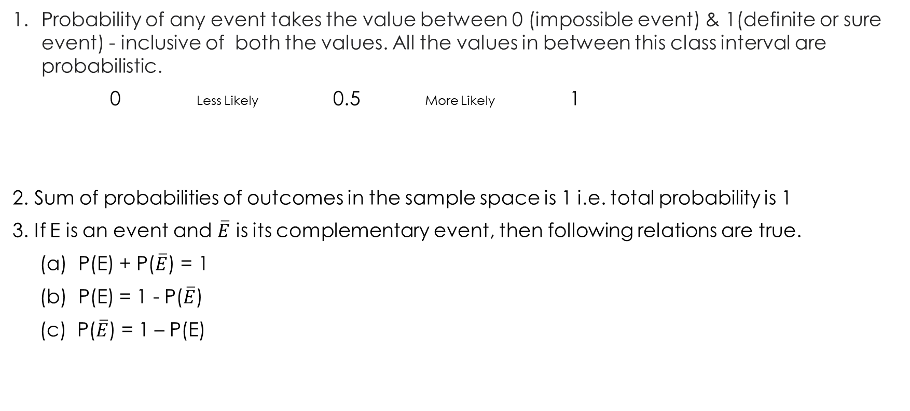
Basic rule of probability
Probability of any event takes the value between 0 (impossible event) & 1(definite or sure event) - inclusive of both the values. All the values in between this class interval are probabilistic.
0 Less Likely 0.5 More Likely 1
2. Sum of probabilities of outcomes in the sample space is 1 i.e. total probability is 1
3. If E is an event and $\overline{E}$ is its complementary event, then following relations are true.
(a) P(E) + P($\overline{E}$) = 1
(b) P(E) = 1 - P($\overline{E}$)
(c) P($\overline{E}$) = 1 – P(E)
Impossible event
Sure Event

Slide 9
Approaches in probability
There are three approaches in defining a probability of an event.
Classical or Priori Approach
Relative Frequency or Empirical Approach
Subjective Approach

Slide 10
Classical definition of probability
If an experiment can produce ‘N’ exhaustive and mutually exclusive outcome, all of which are equally likely and if ‘n’ of these outcome are favorable to happening of event E, the probability of happening of E is given by,
Notes:
Classical probability uses sample space to determine the numerical probability that an event will happen.
It assumes that all outcomes in the sample space are equally likely to occur.
Classical probability is also called priori probability because we can state the probability of event in advance (a priori) without performing an experiment, i.e. probability of success is based on prior knowledge of the process involved.
This approach of probability is useful when we deal with card game, dice games, coin tossing etc.

Slide 11
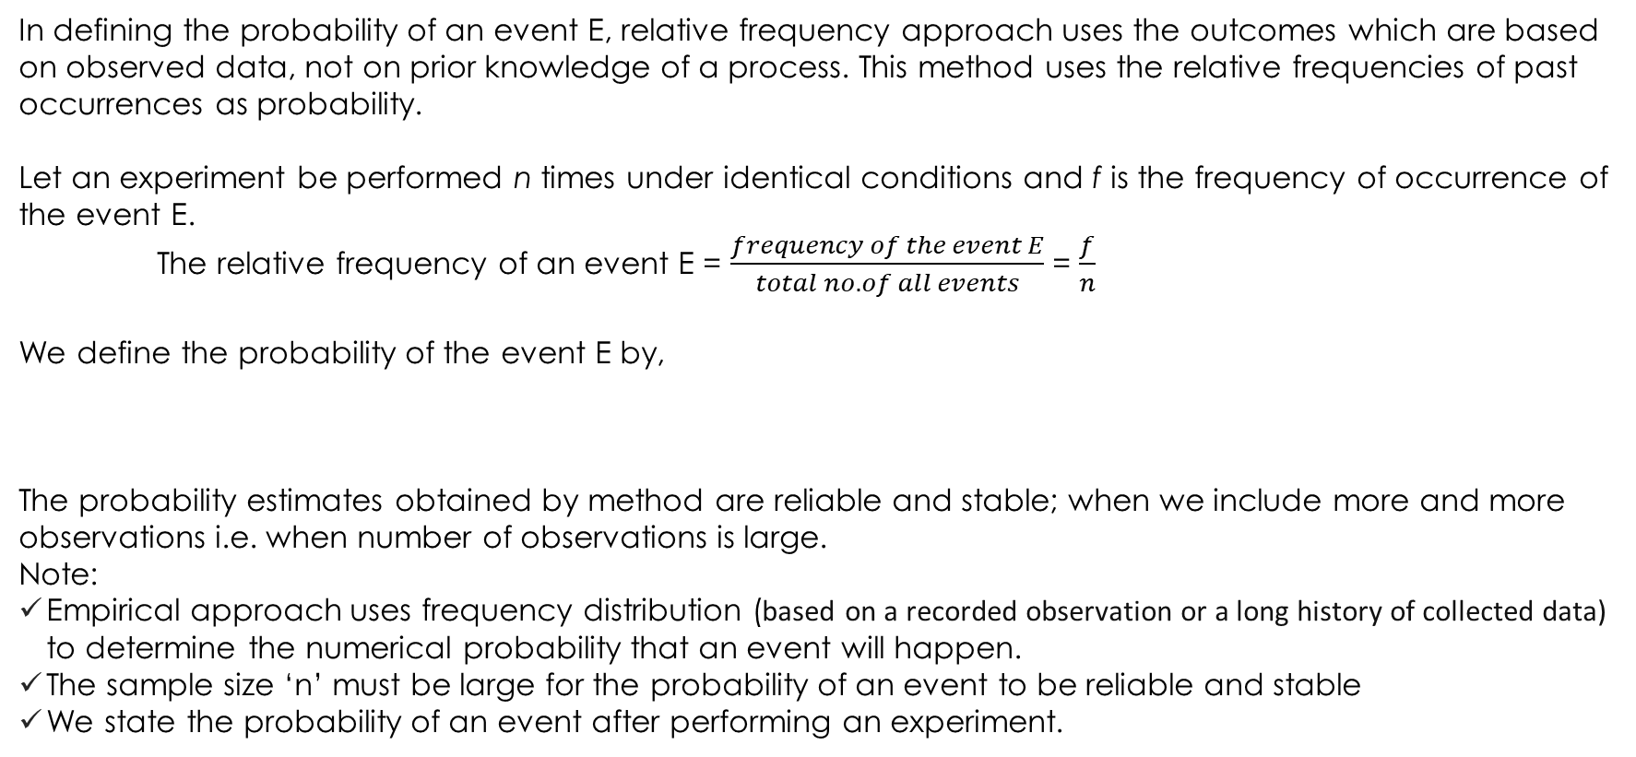
Empirical definition of probability
In defining the probability of an event E, relative frequency approach uses the outcomes which are based on observed data, not on prior knowledge of a process. This method uses the relative frequencies of past occurrences as probability.
Let an experiment be performed n times under identical conditions and f is the frequency of occurrence of the event E.
The relative frequency of an event E = $\frac{frequency of the event E}{total no. of all events}$ = $\frac{f}{n}$
We define the probability of the event E by,
The probability estimates obtained by method are reliable and stable; when we include more and more observations i.e. when number of observations is large.
Note:
Empirical approach uses frequency distribution (based on a recorded observation or a long history of collected data) to determine the numerical probability that an event will happen.
The sample size ‘n’ must be large for the probability of an event to be reliable and stable
We state the probability of an event after performing an experiment.

Slide 12
Subjective Probability
Subjective probability is a type of probability derived from an individual's personal judgment or own experience about whether a specific outcome is likely to occur. It contains no formal calculations and only reflects the subject's opinions and past experience.
This approach is especially used when we do not have historical data relating to the event.
Assessment of probability is based on:
Individual past experience
Personal opinion or belief (highly flexible, even in terms of one individual’s belief)
Analysis of the situation
Knowledge or expertise in the field

Slide 13
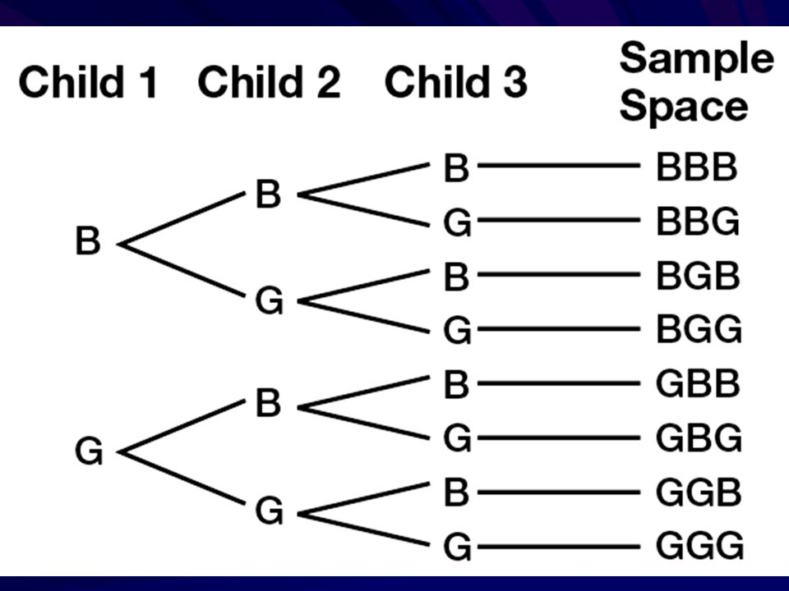
Example 1: In a family of three children (no twins, triplets), find the following probabilities.
All children are girls (b) All children are boys (c) All girls or all boys (d) Exactly two boys
(e) At least one child of each gender (f) gender in alternative form
Solution:
Total no. of cases in the sample space = 2^3 = 8
Sample Space = {BBB, BBG, BGB, BGG, GBB, GBG, GGB, GGG}

Slide 14
Solution:
(a) P (all girls) = No. of cases favorable to the Event / total no. of cases in sample space = n/N = 1/8 = 0.125 = 12.5
(b) P (all boys) = No. of cases favorable to the Event / total no. of cases in sample space = n/N = 1/8 = 0.125 = 12.5
(c) P (all girls or all boys) = Favorable cases / Total cases = n/N = 2 / 8 =1/4 = 0.25 = 25 %
(d) P (exactly two boys) = Favorable cases / Total cases = 3 / 8
= 0.375 = 37.5 %
(e) P (at least one child of each gender) = 6 / 8 = 3 / 4 = 0.75 = 75 %
(f) P (gender in alternative form) = 2 / 8 = 1 / 4 = 0.25 = 25 %

Slide 15
Example 2:
Hospital records of maternity patients who stayed in the hospitals for the number of days is shown in the following distribution.
No. of days stayed (X) 3 4 5 6 7 Total
Frequency (f) 15 32 56 19 8 130
Relative Frequency (f/n)
Find these probabilities:
A patient stayed exactly 5 days
P(X = 5) = P(5 days) = f / n = 56 / 130 = 0.4307
A patient stayed less than 6 days
P(X < 6) = P(less than 6 days) = f / n = (15 + 32 + 56) / 130 = 103 / 130 = 0.7923
A patient stayed at most 4 days
P(at most 4 days) = f / n = (15 + 32) / 130 = 47 / 130 = 0.3615
A patient stayed at least 5 days
P(at least 5 days) = (56 + 19 + 8) / 130 = 83 / 130 = 0.6385
A patient stayed between 4 to 6 days inclusive
P(4 to 6 days) = (32 + 56 + 19) / 130 = 107 / 130 = 0.8231

Slide 16
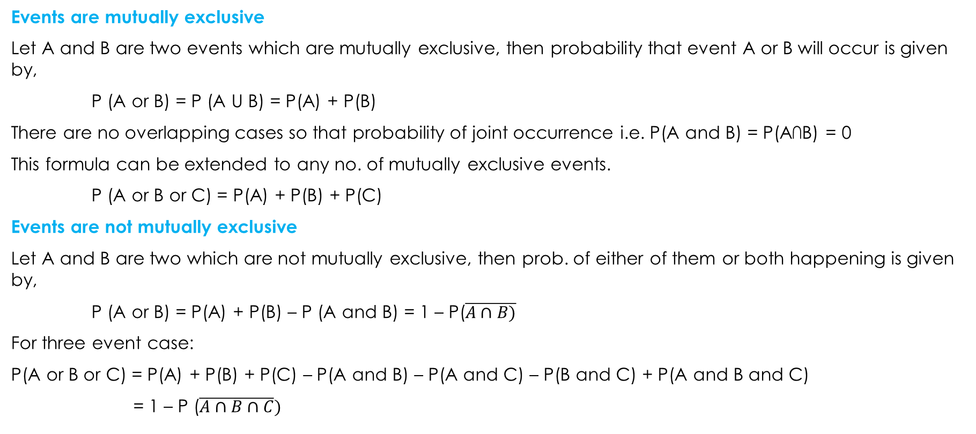
Additional Rule of Probability
Events are mutually exclusive
Let A and B are two events which are mutually exclusive, then probability that event A or B will occur is given by,
P (A or B) = P (A U B) = P(A) + P(B)
There are no overlapping cases so that probability of joint occurrence i.e. P(A and B) = P(A∩B) = 0
This formula can be extended to any no. of mutually exclusive events.
P (A or B or C) = P(A) + P(B) + P(C)
Events are not mutually exclusive
Let A and B are two which are not mutually exclusive, then prob. of either of them or both happening is given by,
P (A or B) = P(A) + P(B) – P (A and B) = 1 – P($\overline{A∩B)}$
For three event case:
P(A or B or C) = P(A) + P(B) + P(C) – P(A and B) – P(A and C) – P(B and C) + P(A and B and C)
= 1 – P ($\overline{A∩B∩C})$

Slide 17
Multiplicative rule of probability
Events are independent (Under statistical independence)
If A and B are two independent events, then probability of their simultaneous occurrence is given by,
P (A and B) = P (A ∩ B) = P(A) . P(B)
P (A and B and C) = P (A ∩ B ∩ C) = P(A) . P(B) . P(C)
Events are dependent (Under statistical dependence)
If A and B are two dependent events, then probability of their joint occurrence is given by,
P (A and B) = P (A ∩ B) = P(A) . P(B/A)
= P(B) . P(A/B)
Notation:
P(B/A) = Conditional probability of an event B given that event A has already occurred
or probability of event B given information about the occurrence of event A.
P (A/B) = Conditional probability of an event A given that event A has already occurred
or probability of event B given information about the occurrence of event B.

Slide 18
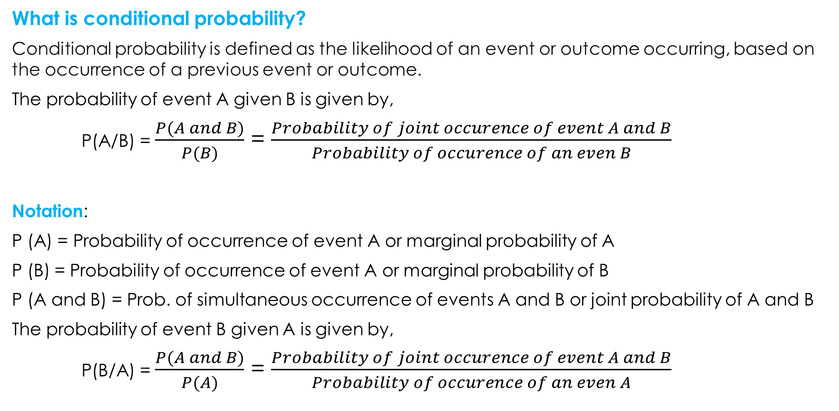
What is conditional probability?
Conditional probability is defined as the likelihood of an event or outcome occurring, based on the occurrence of a previous event or outcome.
The probability of event A given B is given by,
P(A/B) = $\frac{P(A and B)}{P(B)}$ = $\frac{Probability of joint occurence of event A and B}{Probability of occurence of an even B}$
Notation:
P (A) = Probability of occurrence of event A or marginal probability of A
P (B) = Probability of occurrence of event A or marginal probability of B
P (A and B) = Prob. of simultaneous occurrence of events A and B or joint probability of A and B
The probability of event B given A is given by,
P(B/A) = $\frac{P(A and B)}{P(A)}$ = $\frac{Probability of joint occurence of event A and B}{Probability of occurence of an even A}$

Slide 19
Example: One hundred students were surveyed about their preference between dogs and cats. The following two-way table displays data for the sample of students who responded to the survey.
In this sample, are the events "prefers dogs" and "prefers cats" mutually exclusive?
Find the probability that a randomly selected student prefers dogs.
Find the probability that a randomly selected student prefers dogs or is female.
Find the probability that a randomly selected student prefers cats given that he is male.
Are the event of ‘female’ independence of event ‘prefer dogs’?
Preference | Male | Female | Total
Prefers dogs | 120 | 65 | 185
Prefers cats | 70 | 110 | 180
No preference | 10 | 25 | 35
Total | 200 | 200 | n = 400

Slide 20
Solution:
Event D = Prefers dogs Event M = randomly selected student is a male
Event C = Prefers cats Event F = randomly selected student is a female
Events of ‘prefers dogs’ and ‘prefers cats’ are not mutually exclusive, because a same person may prefers both pets.
P(D) = f/n = 185/400 = 0.4625
P (D or F) = P(D) + P(F) - P (D and F) = 185/400 + 200/400 – 65/400 =
P (C/M) = P (C and M)/ P(M) = 70/400 / 200/400 =
Since P (D/M) = 120/200 = 0.6 and P(D/F) = 65/200 = 0.325. It means that male is twice as likely to prefer dog than female. Hence, preference of dog is dependent on gender.
Further,
P(F and D) = 65/400 = 0.1625
and
P(F) . P(D) = 200/400 x 185/400 = 0.23125
Hence, we can say event of student being female and preferring dog are not independent.

Slide 21
Example: In a survey conducted by a college both full time and part-time, students were asked how often they had visited the college’s tutoring center in the last two months. The results may be represented as follows:
What is the probability the student visited the tutoring center four or more times, given that the student is full time?
Suppose that a student is part-time. What is the probability that the student visited the tutoring center one or fewer times?
If the student visited the tutoring center four or more times, what is the probability he or she is a part-time student?
Types of students | Number of times students visited tutoring
 | One or fewer times | Two to three times | Four or more times | Total
Full time | 12 | 25 | 8 | 45
Part time | 2 | 5 | 6 | 13
Total | 14 | 30 | 14 | n = 58

Slide 22
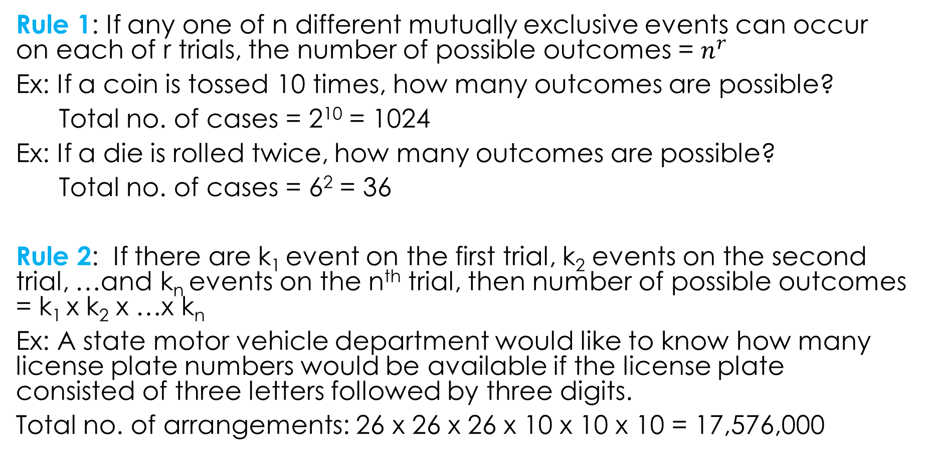
Rules of counting
Rule 1: If any one of n different mutually exclusive events can occur on each of r trials, the number of possible outcomes = $n^{r}$
Ex: If a coin is tossed 10 times, how many outcomes are possible?
Total no. of cases = 2¹⁰ = 1024
Ex: If a die is rolled twice, how many outcomes are possible?
Total no. of cases = 6² = 36
Rule 2: If there are k₁ event on the first trial, k₂ events on the second trial, …and k_{n} events on the n^{th} trial, then number of possible outcomes = k₁ x k₂ x …x k_{n}
Ex: A state motor vehicle department would like to know how many license plate numbers would be available if the license plate consisted of three letters followed by three digits.
Total no. of arrangements: 26 x 26 x 26 x 10 x 10 x 10 = 17,576,000

Slide 23
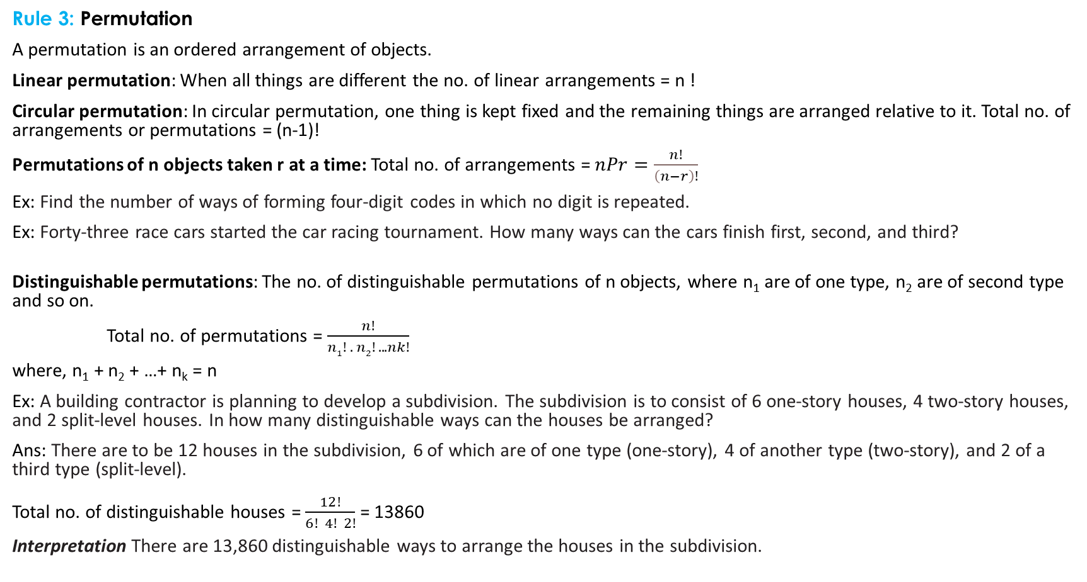
Rule 3: Permutation
A permutation is an ordered arrangement of objects.
Linear permutation: When all things are different the no. of linear arrangements = n !
Circular permutation: In circular permutation, one thing is kept fixed and the remaining things are arranged relative to it. Total no. of arrangements or permutations = (n-1)!
Permutations of n objects taken r at a time: Total no. of arrangements = $nPr=\frac{n!}{\left(n−r\right)!}$
Ex: Find the number of ways of forming four-digit codes in which no digit is repeated.
Ex: Forty-three race cars started the car racing tournament. How many ways can the cars finish first, second, and third?
Distinguishable permutations: The no. of distinguishable permutations of n objects, where n₁ are of one type, n₂ are of second type and so on.
Total no. of permutations = $\frac{n!}{n1! . n2! .. . nk!}$
where, n₁ + n₂ + …+ n_{k} = n
Ex: A building contractor is planning to develop a subdivision. The subdivision is to consist of 6 one-story houses, 4 two-story houses, and 2 split-level houses. In how many distinguishable ways can the houses be arranged?
Ans: There are to be 12 houses in the subdivision, 6 of which are of one type (one-story), 4 of another type (two-story), and 2 of a third type (split-level). Total no. of distinguishable houses = $\frac{12!}{6! 4! 2!}$ = 13860
Interpretation There are 13,860 distinguishable ways to arrange the houses in the subdivision.

Slide 24
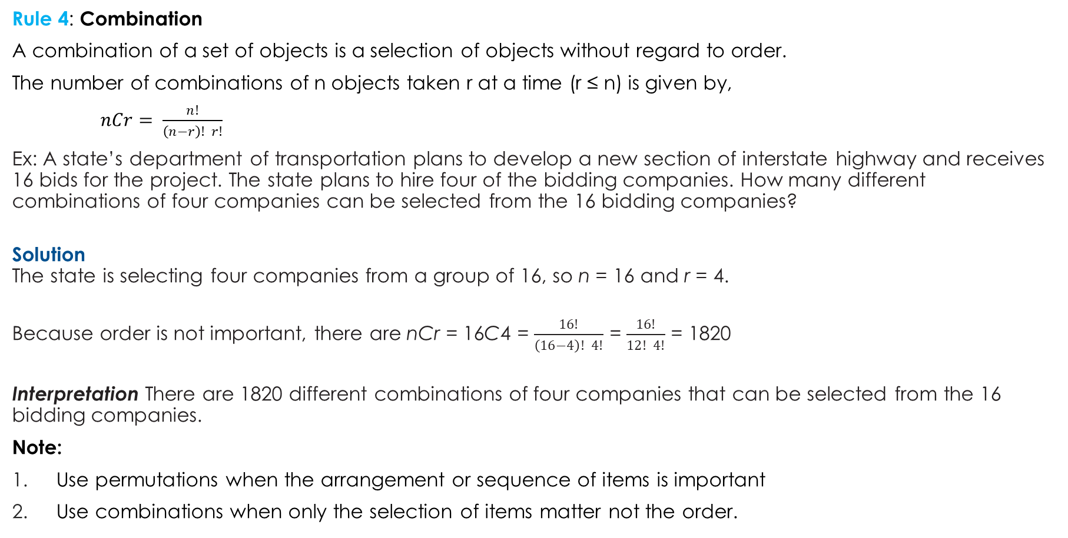
Rule 4: Combination
A combination of a set of objects is a selection of objects without regard to order.
The number of combinations of n objects taken r at a time (r ≤ n) is given by,
$nCr= \frac{n!}{\left(n−r\right)! r!}$
Ex: A state’s department of transportation plans to develop a new section of interstate highway and receives 16 bids for the project. The state plans to hire four of the bidding companies. How many different combinations of four companies can be selected from the 16 bidding companies?
Solution The state is selecting four companies from a group of 16, so n = 16 and r = 4.
Because order is not important, there are nCr = 16C4 = $\frac{16!}{\left(16−4\right)! 4!}$ = $\frac{16!}{12! 4!}$ = 1820
Interpretation There are 1820 different combinations of four companies that can be selected from the 16 bidding companies.
Note:
Use permutations when the arrangement or sequence of items is important
Use combinations when only the selection of items matter not the order.

Slide 25
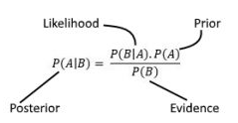
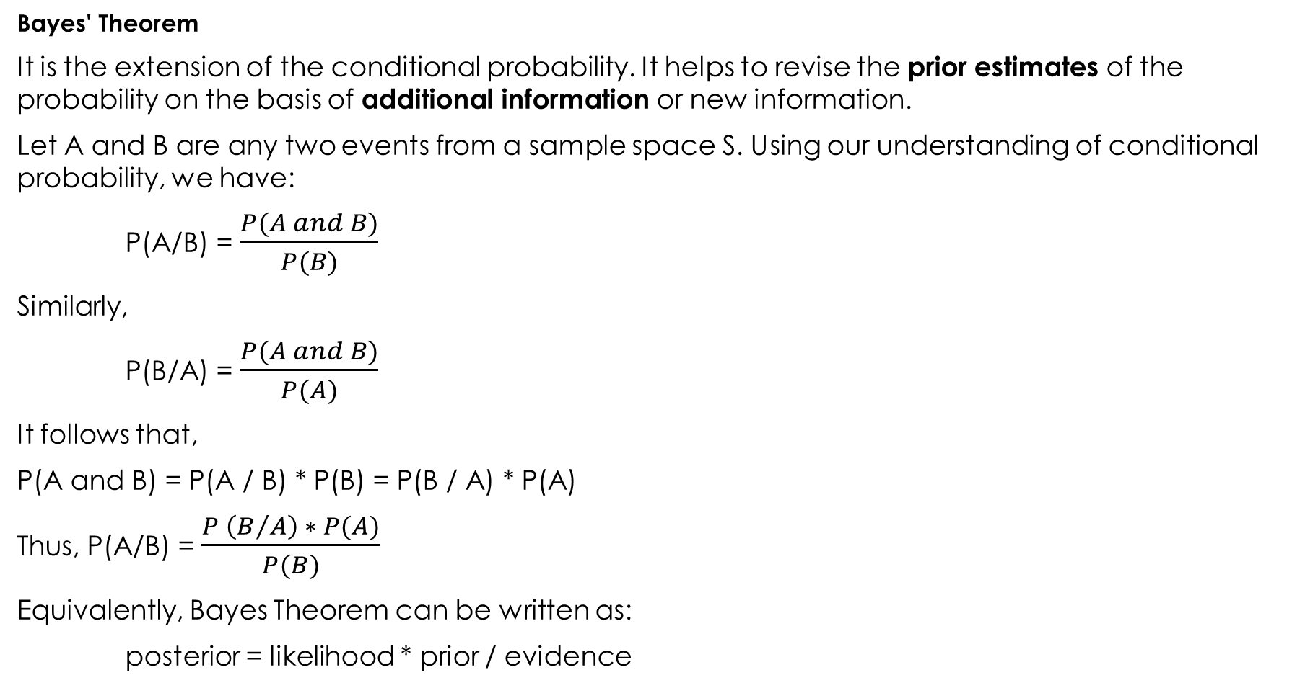
P(A ∩ B) = P(A|B) * P(B) = P(B|A) * P(A)
Bayes' Theorem
It is the extension of the conditional probability. It helps to revise the prior estimates of the probability on the basis of additional information or new information.
Let A and B are any two events from a sample space S. Using our understanding of conditional probability, we have:
P(A/B) = $\frac{P(A and B)}{P(B)}$
Similarly,
P(B/A) = $\frac{P(A and B)}{P(A)}$
It follows that,
P(A and B) = P(A / B) * P(B) = P(B / A) * P(A)
Thus, P(A/B) = $\frac{P \left(B/A\right) ∗ P(A)}{P(B)}$
Equivalently, Bayes Theorem can be written as:
posterior = likelihood * prior / evidence

Slide 26

Formulae for Bayes theorem
Let us now understand each term of the Bayes’ Theorem formula in detail –
P(H | E) – This is referred to as the posterior probability. It denotes the conditional probability of H (hypothesis), given the evidence E.
P(E | H) – It denotes the likelihood. It is the conditional probability of the occurrence of the evidence E, given the hypothesis H. It calculates the probability of the evidence, considering that the assumed hypothesis holds true.
P(H) – This is referred to as the prior probability. It denotes the original probability of the hypothesis H being true before the implementation of Bayes’ Theorem i.e. initial probability of hypothesis H without seeing the data or the evidence E.
P(E) – This is the evidence or marginal likelihood. This is the probability of the occurrence of evidence E regardless of the hypothesis.

Slide 27
Let's break down each term:
Posterior ( P(H∣E) ): This is the updated probability of the hypothesis H after considering the new evidence E. It's called the "posterior" because it comes after (post) taking the evidence into account. The posterior combines the prior belief and the likelihood of the evidence.
Likelihood ( P(E∣H) ): The likelihood represents how probable the evidence E is, assuming that the hypothesis H is true. It measures the support that the evidence provides for the hypothesis.
Prior ( P(H) ): The prior probability is the initial belief about the hypothesis H before seeing any evidence. It reflects the degree of belief in the hypothesis based on previous knowledge or assumptions.
Evidence ( P(E) ): The evidence, also known as the marginal likelihood or normalizing constant, is the overall probability of observing the evidence E under all possible hypotheses. It ensures that the posterior probabilities sum to 1. It can be computed as: P(E)=∑P(E/Hi) * P (Hi), where the sum is over all possible hypotheses HiH_iHi​.

Slide 28
Suppose we want to diagnose whether a person has a certain disease (hypothesis H) based on a test result (evidence E).
Prior ( P(H) ): The initial probability of having the disease before knowing the test result.
For instance, if 1% of the population has the disease, P(H)=0.01
Likelihood ( P(E∣H) ): The probability of the test being positive given that the person has the disease.
For example, if the test is 99% accurate, P(E∣H)=0.99
Evidence ( P(E) ): The overall probability of getting a positive test result. This includes both those with and without the disease. If the test has a 5% false positive rate and the disease prevalence is 1%, this can be calculated using the law of total probability.
Posterior ( P(H∣E) ): The updated probability that the person has the disease given the positive test result. This is calculated using Bayes' Theorem.

Slide 29
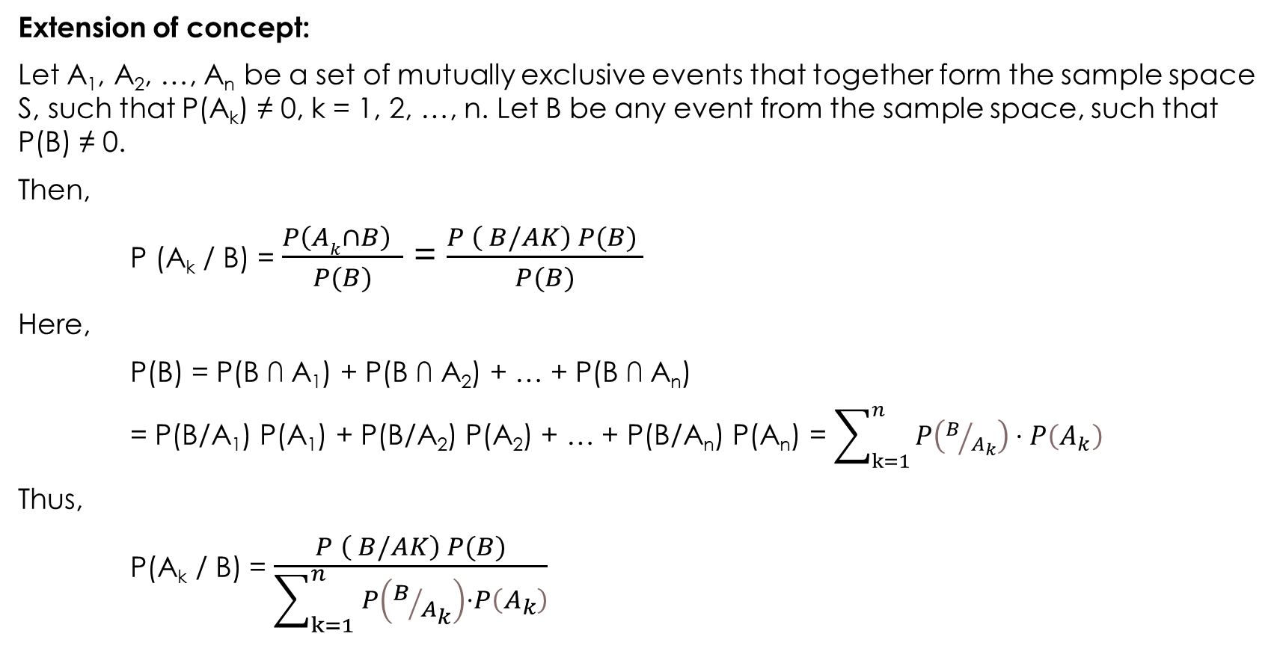
Extension of concept:
Let A₁, A₂, …, A_{n} be a set of mutually exclusive events that together form the sample space S, such that P(A_{k}) ≠ 0, k = 1, 2, …, n. Let B be any event from the sample space, such that P(B) ≠ 0.
Then,
P (A_{k} / B) = $\frac{P\left(Ak∩B\right) }{P(B)}$ = $\frac{P \left( B/AK\right) P(B) }{P(B)}$
Here,
P(B) = P(B ∩ A₁) + P(B ∩ A₂) + … + P(B ∩ A_{n})
= P(B/A₁) P(A₁) + P(B/A₂) P(A₂) + … + P(B/A_{n}) P(A_{n}) = $\sum_{k=1}^{n}{P\left(B/{A_{k}}\right)}⋅P\left(A_{k}\right)$
Thus,
P(A_{k} / B) = $\frac{P \left( B/AK\right) P(B)}{\sum_{k=1}^{n}{P\left(B/{A_{k}}\right)}⋅P\left(A_{k}\right)}$

Slide 30
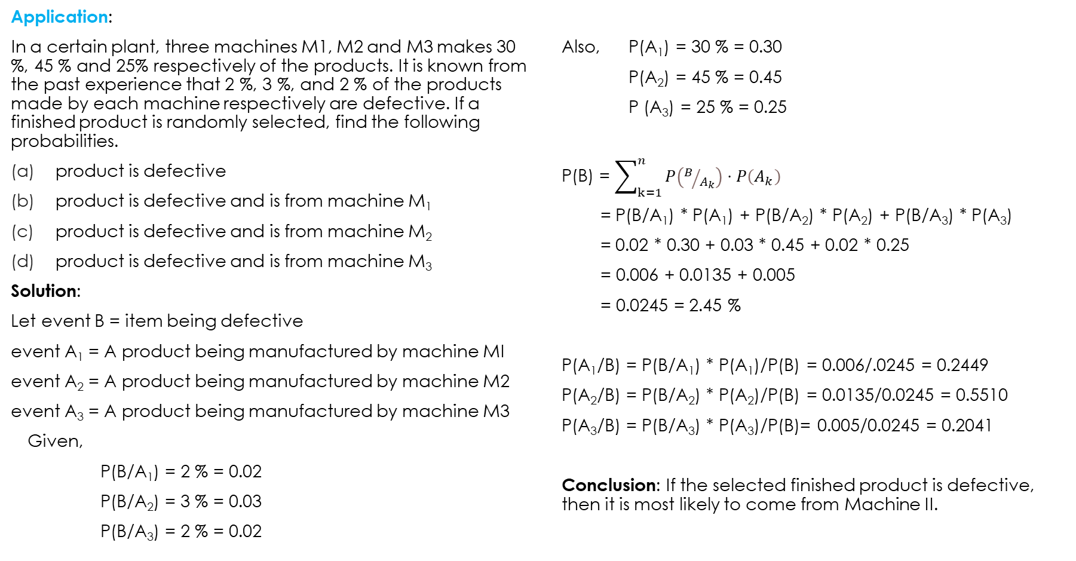
Application:
In a certain plant, three machines M1, M2 and M3 makes 30 %, 45 % and 25% respectively of the products. It is known from the past experience that 2 %, 3 %, and 2 % of the products made by each machine respectively are defective. If a finished product is randomly selected, find the following probabilities.
product is defective
product is defective and is from machine M₁
product is defective and is from machine M₂
product is defective and is from machine M₃
Solution:
Let event B = item being defective
event A₁ = A product being manufactured by machine MI
event A₂ = A product being manufactured by machine M2
event A₃ = A product being manufactured by machine M3
Given,
P(B/A₁) = 2 % = 0.02
P(B/A₂) = 3 % = 0.03
P(B/A₃) = 2 % = 0.02
Also, P(A₁) = 30 % = 0.30
P(A₂) = 45 % = 0.45
P (A₃) = 25 % = 0.25
P(B) = $\sum_{k=1}^{n}{P\left(B/{A_{k}}\right)}⋅P\left(A_{k}\right)$
= P(B/A₁) * P(A₁) + P(B/A₂) * P(A₂) + P(B/A₃) * P(A₃)
= 0.02 * 0.30 + 0.03 * 0.45 + 0.02 * 0.25
= 0.006 + 0.0135 + 0.005
= 0.0245 = 2.45 %
P(A₁/B) = P(B/A₁) * P(A₁)/P(B) = 0.006/.0245 = 0.2449
P(A₂/B) = P(B/A₂) * P(A₂)/P(B) = 0.0135/0.0245 = 0.5510
P(A₃/B) = P(B/A₃) * P(A₃)/P(B)= 0.005/0.0245 = 0.2041
Conclusion: If the selected finished product is defective, then it is most likely to come from Machine II.

Slide 31
Uses in computer science
Bayes’ Theorem is the most important concept in Data Science. It is most widely used in Machine Learning as a classifier that makes use of Naive Bayes’ Classifier. It has also emerged as an advanced algorithm for the development of Bayesian Neural Networks. Bayesian algorithm is used cyber security to filter the spam mail. The applications of Bayes’ Theorem are everywhere in the field of Data Science.
(Do some research on this topic and prepare a short article of it and if possible send me your finished article. This will enhance your information seeking capability, writing skill and presentation)

Slide 32
Problems
1. A computer assembly company receives 24 % of parts from supplier X, 36 % from supplier Y, and remaining 40 % of parts from supplier Z. From the past record, 5 % of parts supplied by X, 10 % of parts supplied by Y and 6 % of parts supplied by Z are defective.
What is the probability of parts being defective
If an assembled computer has a defective parts on it, what is the chance that this part was received from supplier X
If an assembled computer has a defective parts on it, what is the chance that this part was received from supplier Y
If an assembled computer has a defective parts on it, what is the chance that this part was received from supplier Z
2. A printer manufacturer obtained the following probabilities from a database of test results. Printer failures are associated with three types of problems: hardware, software, and other (such as connectors) with probabilities of 0.1, 0.6, and 0.3, respectively. The probability of a printer failure given a hardware problem is 0.9, given a software problem is 0.2, and given any other type of problem is 0.5. If a customer enters the manufacturer’s Web site to diagnose a printer failure, what is the most likely cause of the problem?

Slide 33
3. Ninety percent of flights depart on time. Eighty percent of flights arrive
on time. Seventy-five percent of flights depart on time and arrive on time.
(a) You are meeting a flight that departed on time. What is the probability that it will
arrive on time?
(b) You have met a flight, and it arrived on time. What is the probability that it departed
on time ?(c) Are the events, departing on time and arriving on time, independent?
4. A certain virus infects one in every 400 people. A test used to detect the virus in a person is positive 85% of the time if the person has the virus and 5% of the time if the person does not have the virus. (This 5% result is called a false positive). Let A be the event "the person has the virus" and B be the event "the person tests positive". a) Find the probability that a person has the virus given that they have tested positive, i.e. find P(A|B). Round your answer to the nearest hundredth of a percent. b) Find the probability that a person does not have the virus given that they test negative, i.e. find P(A'|B').

Slide 34
5. Three facilities supply microprocessors to a manufacturer of telemetry equipment. All are supposedly made to the same specifications. However, the manufacturer has for several years tested the microprocessors, and records indicate the following information:
The director of the manufacturing randomly selects a microprocessor, takes it to the test
department, and finds that it is defective.
(a) What is the probability of a microprocessor being defective?
(b) If a microprocessor found to be defective what is the chance that it is produced by facility
A, B and C respectively?
(c) Interpret the probabilities obtained in step (b)
Supplying Facility | Fraction Defective | Fraction Supplied
A | 0.02 | 0.15
B | 0.01 | 0.80
C | 0.03 | 0.05

